Slide 1


Analysis of Variability in the JWST North Ecliptic Pole (NEP) Time Domain Field (TDF)
Victoria Jones
Dr. Rolf Jansen

Slide 2
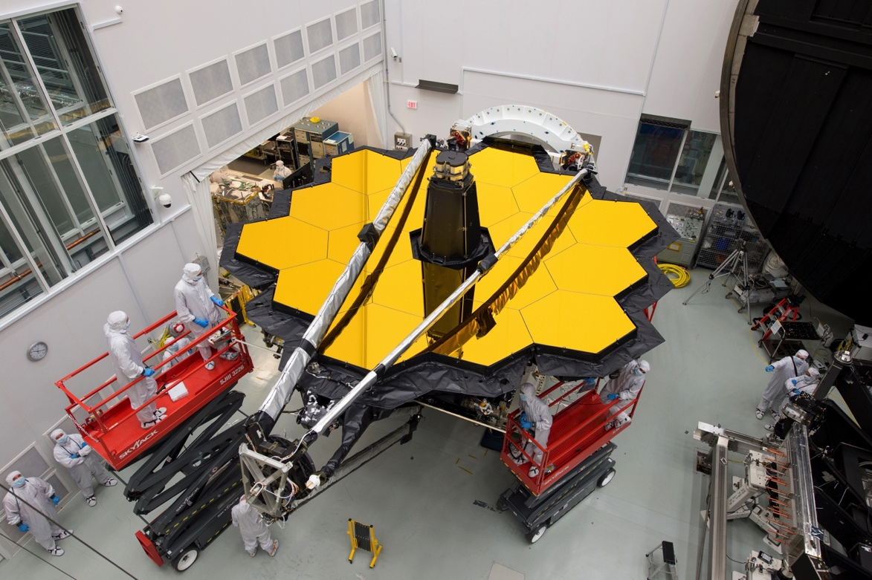
JWST NEP TDF
Located within JWST’s northern Continuous Viewing Zone centered on the NEP
Void of bright foreground stars and low galactic foreground extinction
Community field for
time domain science
Image Credit: Desiree Stover/NASA

Slide 3
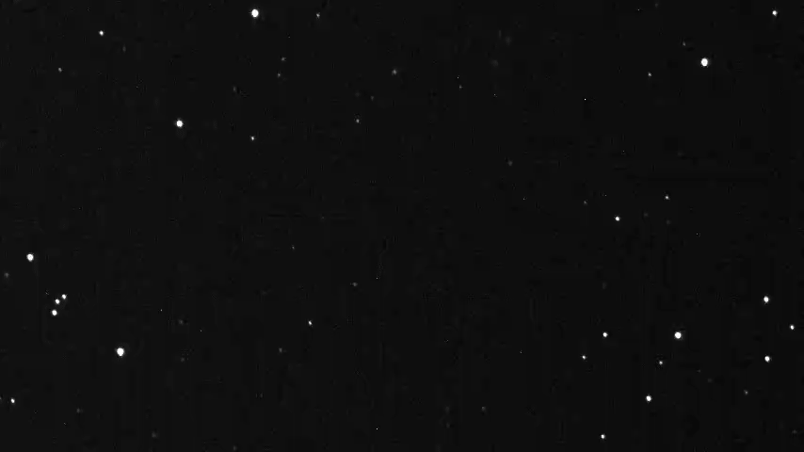
Variability Background: Astrometry
Image Credit: Kiso Observatory, University of Tokyo

Slide 4
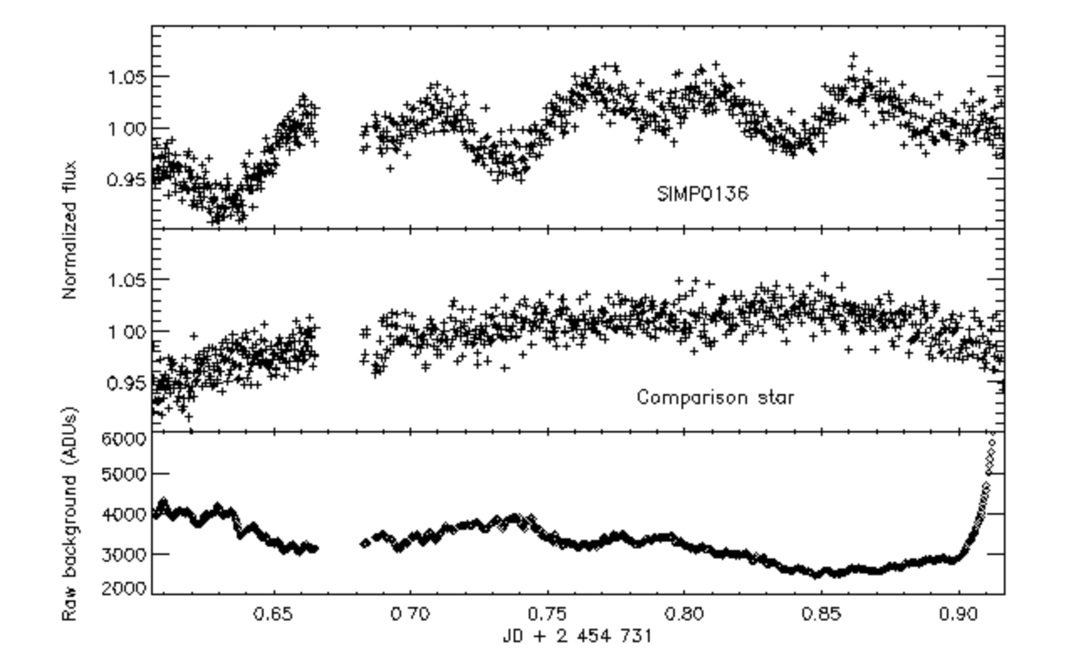
Variability Background: Photometry
Image Credit: Artigau et al. 2009

Slide 5
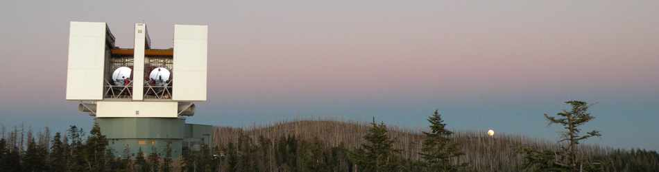
Large Binocular Telescope Data
Large Binocular Camera Filters (U, g, r, z)
Observed July 2016 for half a night
  Equivalent to full night on 8.4 m telescope
  Median seeing ~ 0.95” with depth ~ 26 AB magnitude
  Observations part of the field selection
Image Credit: Large Binocular Telescope Observatory Website

Slide 6
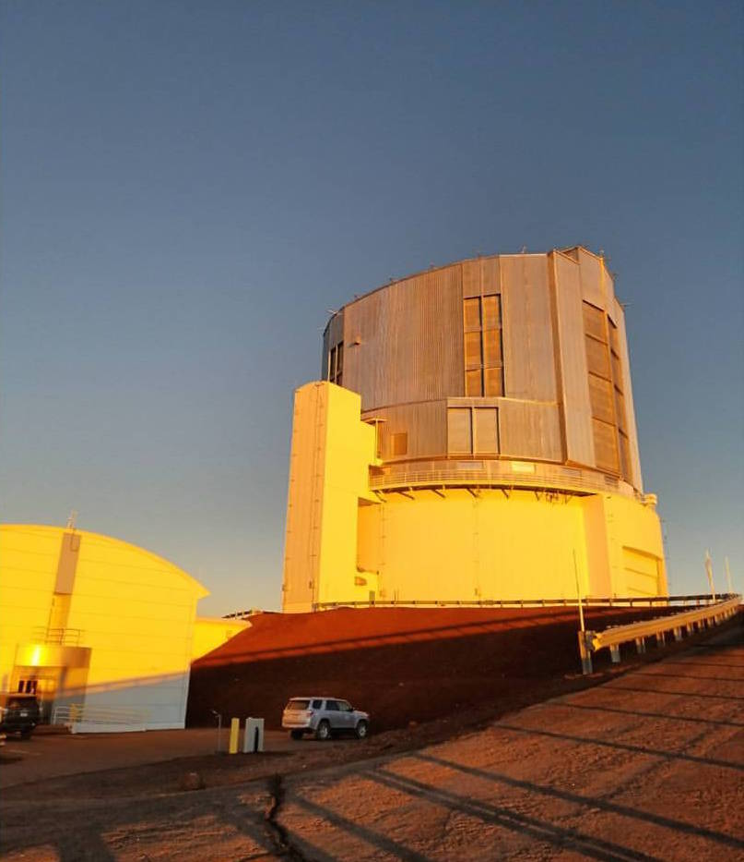
Subaru Observations and Data
Hyper Suprime-Cam Filters (g, i, z, NB816, NB921)
Observed June 2017 over five nights
  Seeing between ~ 0.5”
  and 1.0” with depth ~ 24-26 AB magnitude
  Observations part of larger
  HEROES survey
  Almost 1 year after LBT data
Image Credit: Cameron White

Slide 7
Project Outline
Match the Subaru and LBT catalogs by Right Ascension and Declination for one filter (g)
Astrometrically cross-register the Subaru and LBT images with milli-arcsec precision
Identify moving objects (comets, galactic stars, brown dwarfs) and objects changing in brightness (active galactic nuclei, brown dwarfs)

Slide 8
Results: Astrometry
24,013 matched sources
2” distance cut applied
Distance Standard Deviation: 0.1828”
1,279 objects with ≥ 3σ distances

Slide 9
Results: Photometry
Cuts Applied:
g_{HSC} ≤ 27 mag
g_{LBC} ≤ 28 mag
LBT objects systematically measured 0.127 mag brighter

Slide 10
Results: Photometry
Standard Deviation split by mag bins
304 objects with Δmag ≥ 3σ

Slide 11
Future Work
Improve the LBT astrometry
Obtain Subaru images and visually inspect candidates
Repeat analysis for z-band filter
Incorporate data taken by Hubble Space Telescope
  Better resolution than either LBT or Subaru

Slide 12





Acknowledgments
Collaborators: Rogier Windhorst, Seth Cohen, Teresa Ashcraft, & NEP TDF team
Guenther Hasinger, Esther Hu, Christopher Waters and the HEROES team at the Institute for Astronomy at University of Hawaii
ASU/NASA Space Grant Consortium

